Slide 1
Recent Research on Labor Supply: Implications for Tax and Transfer Policy
Michael P. Keane
University of New South Wales
Al Rees Lecture – June 26, 2020
EALE SOLE AASLE

Slide 2
Introduction
Recent work on labor supply challenges much of the conventional wisdom about labor supply elasticities
Focus of this talk: What does the recent work on labor supply imply about optimal design of the tax and transfer system?
Important: Design of a tax and transfer system that promotes both economic efficiency and equity is a key challenge facing government.
Notes:
In these talk I want to explore what this work implies about optimal tax structure.

Slide 3
Background
Optimal Tax Theory: How to Design the tax/transfer system to balance competing objectives:
Taxes have benefits:
  Revenue to provide useful public services
  Progressive taxes + Transfers reduce inequality
But Taxes also distort economic activity:
  E.g., taxes may reduce labor supply and output.
Key idea – To minimize distortions: Focus taxes on activities that are inelastically supplied.

Slide 4
Background
Labor supply elasticities are critical inputs to optimal tax calculations. Optimal Tax theory says:
If Labor Supply Elasticities are Larger then:
  Optimal tax rates on Labor are Lower
  Optimal tax rate on Capital is Higher
Demographic groups with more elastic labor supply should be taxed less
  E.g., workers near retirement, married women

Slide 5
Two Classic Papers
Mirrlees (RES 1971) “An Exploration in the Theory of Optimal Income Taxation”
Total output depends on aggregate labor supply
A social planner, who cares about both total output and distributional equity, designs an optimal income tax/transfer system
In the simple model of labor supply that Mirrlees relies on, labor supply is very elastic.
So taxes on labor earnings lead to large reductions in work effort and output

Slide 6
Two Classic Papers
Given Mirrlees set up, it is not surprising that:
  The optimal income tax design is approximately a flat rate tax.
  The optimal top bracket tax rate on labor income is very low (roughly 20%).
  Transfers to low wage workers are modest.

Slide 7
Two Classic Papers
Summers (AER 1981) considers a macro model with saving/capital endogenous
Output depends on capital stock + labor supply
Government levies income, capital and sales tax
In contrast to Mirrlees, in Summer’s simple model, labor supply is inelastic.
So work effort is little affected by the income tax

Slide 8
Two Classic Papers
In the model, savings is very elastically supplied. <In contrast to inelastic labor>
A tax on capital, which reduces the after-tax rate of interest, greatly reduces savings and capital formation
Causing wages to fall greatly in the long-run
Given this set up, it is not surprising Summers finds the optimal policy is:
  Do not tax capital at all
  Finance government purely through income and/or sales taxes

Slide 9
Classic Theory Papers:
Should Capital be Taxed?
There are also well-known theoretical results saying capital should not be taxed at all:
  Atkinson-Stiglitz (1976), Judd (1985), Chamley (1986)
The negative impact of capital taxes on capital stock and wages in the long-run is so severe that workers are better off with an earnings tax.
  Note: This is for models with infinitely lived agents (or dynastic linkages)

Slide 10
These Results Are Influential
Results like those in Mirrlees (1971) and Summers (1981), plus the theory results, and later papers like Hausman (1981), seem influential:
Over the past 30 to 40 years most OECD countries have shifted towards:
  1) Less progressive income tax schedules with lower top rates, and
  2) Lower tax rates on capital income
Average top income tax rate in OECD fell from 62% in 1980 to 40% in 1999 – see Gerber et al (OBES 2020)

Slide 11
A Puzzle
Interestingly, these two policies derive from contradictory views about labor supply elasticities:
  Elastic → A relatively flat tax on earnings with a low top rate
  Inelastic → Low tax rates on capital income
Elastic labor supply may justify low tax rates on earnings, but it also implies shifting more of the tax burden onto capital.

Slide 12
Recent Work on Optimal Taxes
Since the early work of Mirrlees and Summers, subsequent work on optimal tax has relied on increasingly sophisticated macro models:
Dynamic stochastic general equilibrium models (DSGE), incorporating overlapping generations (OLG) of heterogeneous consumers
But the treatment of labor supply in these models has generally remained very simple
  A point I’ll return to later

Slide 13
Recent Work on Optimal Taxes
Conesa, Kitao and Krueger (AER 2009) is a key recent paper in the DSGE-OLG framework.
In their model:
  Labor supply is elastic (Frisch = 1.0)
  Workers face wage shocks and borrowing constraints
  Wages are exogenous: Not affected by human capital investment
  Hours is a choice variable, but…
  Labor force participation is not a choice (all agents work up until a fixed retirement age)

Slide 14
Conesa, Kitao, Krueger (AER 2009)
Calibrating their model to fit US data, they solve for an optimal tax structure that involves:
  A 36% tax on capital income
  An income tax with a US$7,200 deduction followed by a 23% flat rate.
The high capital tax is surprising, given the strong prior consensus of economists that capital should not be taxed.

Slide 15
Why Such a high tax on Capital?
First, note that theoretical results saying capital should not be taxed at all
  Atkinson-Stiglitz (1976), Judd (1985), Chamley (1986)
Applies to models with infinitely lived agents (or
dynastic linkages)
It does not carry over to models with overlapping generations of finite lived heterogeneous agents, as Conesa, Kitao, Krueger (AER 2009) illustrates.

Slide 16
Conesa, Kitao, Krueger (AER 2009)
Conesa et al (2009) show two main features of their model drive the high capital tax:
  Elastic labor supply (Frisch = 1), and
  Labor supply elasticities grow with age
“Without labor being supplied elastically, no robust argument can be made for significantly positive capital income taxes.”
So let’s start by looking at labor supply elasticities
  Is the literature consistent with Frisch = 1 ??
<Later I’ll ask whether elasticities grow with age>

Slide 17
How elastic is labor supply?
Until recently, there was a clear consensus in the economics profession that labor supply elasticities are small:
Saez, Slemrod and Giertz (JEL 2012):
“…the profession has settled on a value … for [the compensated (Hicks) elasticity] close to zero … This implies that the efficiency cost of taxing labor income … is bound to be low …”

Slide 18
Different Definitions of Elasticity
Frisch = response of hours to anticipated wage or tax change, no wealth effect
  Frisch ≈ response of hours to transitory wage or tax change, (almost no wealth effect)
Hicks = response of hours to permanent wage or tax change, compensated for the wealth effect
  (to isolate the substitution effect)
Marshall = response of hours to permanent wage or tax change (uncompensated)
In a life-cycle model with exogenous wages:
        Frisch > Hicks > Marshall

Slide 19
Classic Papers Find Inelastic Labor Supply:
Estimates of the Frisch elasticity:
  MaCurdy (JPE, 1981) – 0.15
  Browning, Deaton and Irish (1985) – 0.09
  Altonji (JPE,1986) – 0.17
  Blundell and Walker (1986) – 0.03
As Frisch > Hicks, this implies the Hicks (comp.) elasticity is small as well.
Why are Frisch Elasticity Estimates So Small?

Slide 20
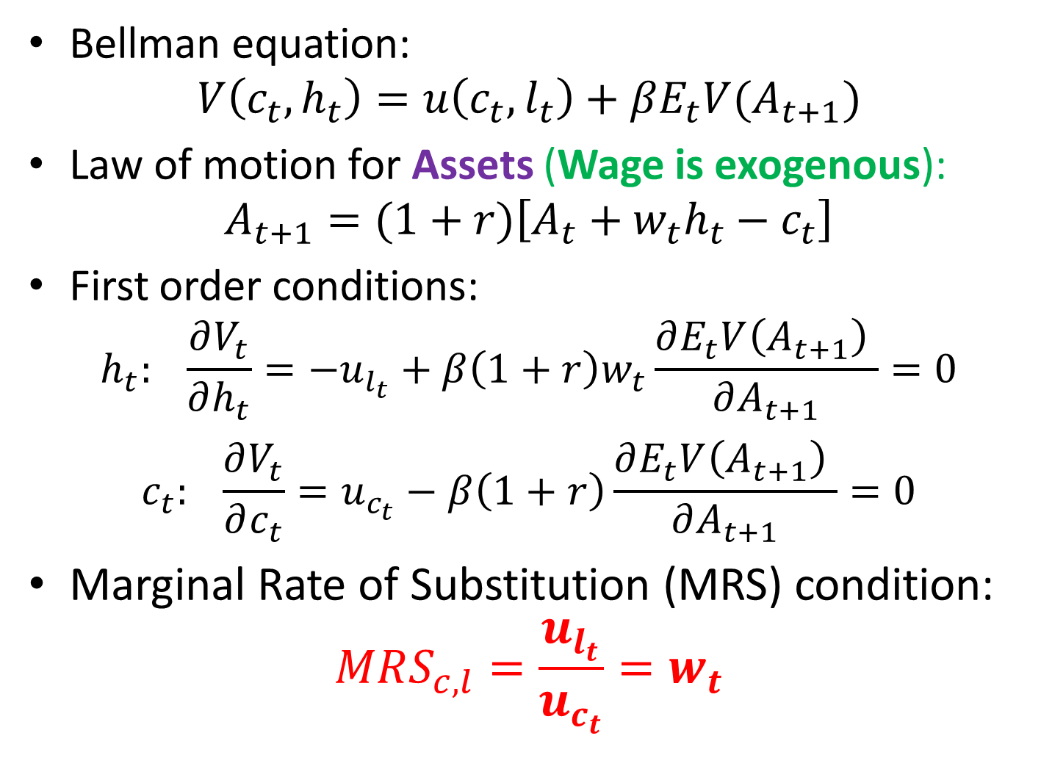
The Basic Life Cycle Model
Bellman equation:
$$V\left(c_{t},h_{t}\right)=u\left(c_{t},l_{t}\right)+βE_{t}V(A_{t+1})$$
Law of motion for Assets (Wage is exogenous):
$$A_{t+1}=(1+r)\left[A_{t}+w_{t}h_{t}−c_{t}\right]$$
First order conditions:
$$h_{t}: \frac{∂V_{t}}{∂h_{t}}=−u_{l_{t}}+β\left(1+r\right)w_{t}\frac{∂E_{t}V\left(A_{t+1}\right) }{∂A_{t+1}}=0$$
$$c_{t}: \frac{∂V_{t}}{∂c_{t}}=u_{c_{t}}−β\left(1+r\right)\frac{∂E_{t}V\left(A_{t+1}\right) }{∂A_{t+1}}=0$$
Marginal Rate of Substitution (MRS) condition:
$$MRS_{c,l}=\frac{u_{l_{t}}}{u_{c_{t}}}=w_{t}$$

Slide 21
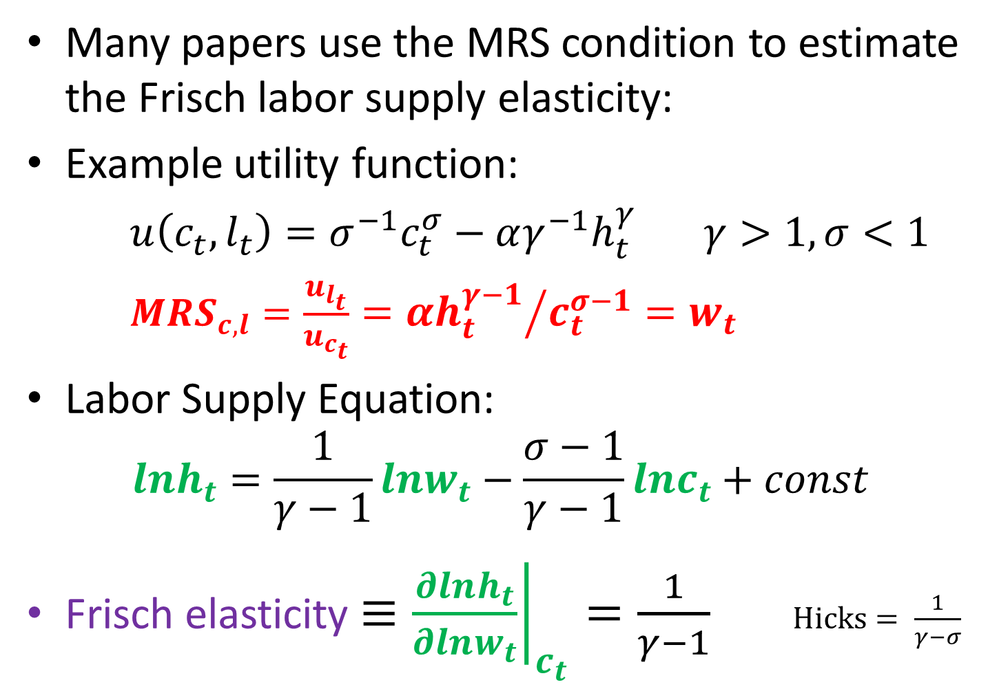
The Basic Life Cycle Model
Many papers use the MRS condition to estimate the Frisch labor supply elasticity:
Example utility function:
$u\left(c_{t},l_{t}\right)=σ^{−1}c_{t}^{σ}−αγ^{−1}h_{t}^{γ}$ $γ>1,σ<1$
$MRS_{c,l}=\frac{u_{l_{t}}}{u_{c_{t}}}={αh_{t}^{γ−1}}/{c_{t}^{σ−1}=w_{t}}$
Labor Supply Equation:
$$lnh_{t}=\frac{1}{γ−1}lnw_{t}−\frac{σ−1}{γ−1}lnc_{t}+const$$
Frisch elasticity $≡{\left.\frac{∂lnh_{t}}{∂lnw_{t}}\right|}_{c_{t}}=\frac{1}{γ−1}$ $Hicks= \frac{1}{γ−σ}$

Slide 22
Why are Frisch Elasticity Estimates So Small?
Hours vs. Wages over the Life-Cycle (Men):
The typical wage path over the life cycle is much steeper than the hours path
Given this pattern, and assuming exogenous wages, the Frisch elasticity must be very small.
Hours, Wage
Wage
Hours
Age

Slide 23
Why are Frisch Elasticity Estimates So Small?
These regressions of Log Hours on Log Wages yield a small Frisch elasticity because wages vary much more than hours over the life-cycle.
But if we extend the life-cycle model to account for human capital, we see such regressions are mis-specified.

Slide 24
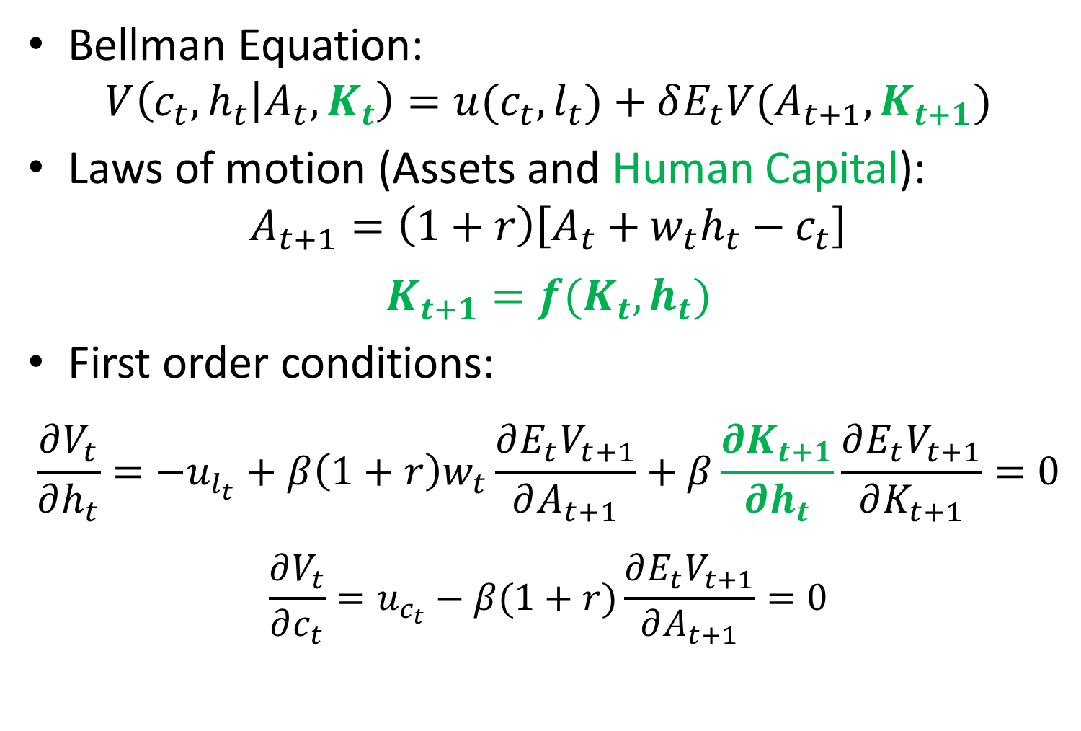
Extension: Work experience builds Human Capital
Bellman Equation:
$$V\left(c_{t},h_{t} | A_{t},K_{t}\right)=u(c_{t},l_{t})+δE_{t}V(A_{t+1},K_{t+1})$$
Laws of motion (Assets and Human Capital):
$$A_{t+1}=\left(1+r\right)\left[A_{t}+w_{t}h_{t}−c_{t}\right]$$
$$K_{t+1}=f(K_{t},h_{t})$$
First order conditions:
$$\frac{∂V_{t}}{∂h_{t}}={−u}_{l_{t}}+β\left(1+r\right)w_{t}\frac{∂E_{t}V_{t+1}}{∂A_{t+1}}+β\frac{∂K_{t+1}}{∂h_{t}}\frac{∂E_{t}V_{t+1}}{∂K_{t+1}}=0$$
$$\frac{∂V_{t}}{∂c_{t}}=u_{c_{t}}−β(1+r)\frac{∂E_{t}V_{t+1}}{∂A_{t+1}}=0$$
Effect of work hours on next period’s Human Capital

Slide 25
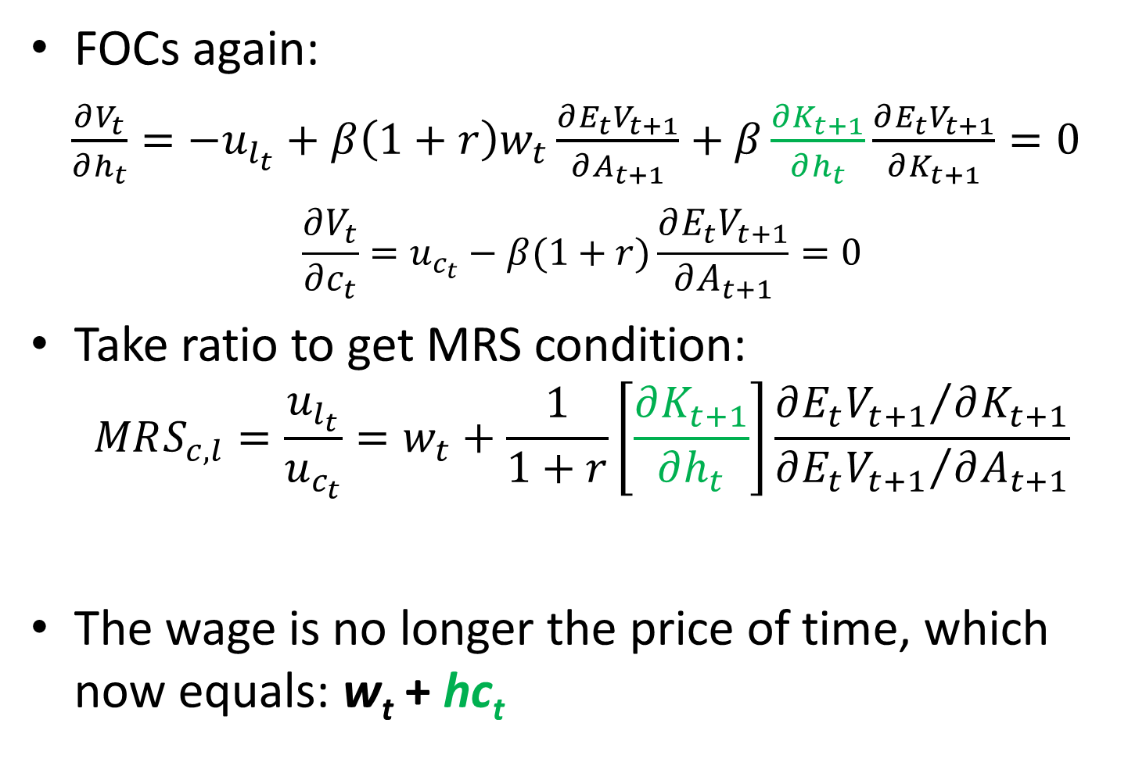
Extension: Work experience builds Human Capital
FOCs again:
$\frac{∂V_{t}}{∂h_{t}}={−u}_{l_{t}}+β\left(1+r\right)w_{t}\frac{∂E_{t}V_{t+1}}{∂A_{t+1}}+β\frac{∂K_{t+1}}{∂h_{t}}\frac{∂E_{t}V_{t+1}}{∂K_{t+1}}=0$
$$\frac{∂V_{t}}{∂c_{t}}=u_{c_{t}}−β(1+r)\frac{∂E_{t}V_{t+1}}{∂A_{t+1}}=0$$
Take ratio to get MRS condition:
$$MRS_{c,l}=\frac{u_{l_{t}}}{u_{c_{t}}}=w_{t}+\frac{1}{1+r}\left[\frac{∂K_{t+1}}{∂h_{t}}\right]\frac{{∂E_{t}V_{t+1}}/{∂K_{t+1}}}{{∂E_{t}V_{t+1}}/{∂A_{t+1}}}$$
The wage is no longer the price of time, which now equals: w_{t} + hc_{t}
Usual MRS = wage condition
Human capital return = hc_{t}

Slide 26
Extension: Work experience builds Human Capital
Once we introduce human capital, the return to a unit of work time is:
  The wage, plus:
  The value of the human capital acquired through work experience
The “effective wage” or “price of time” is the sum of these two components.

Slide 27
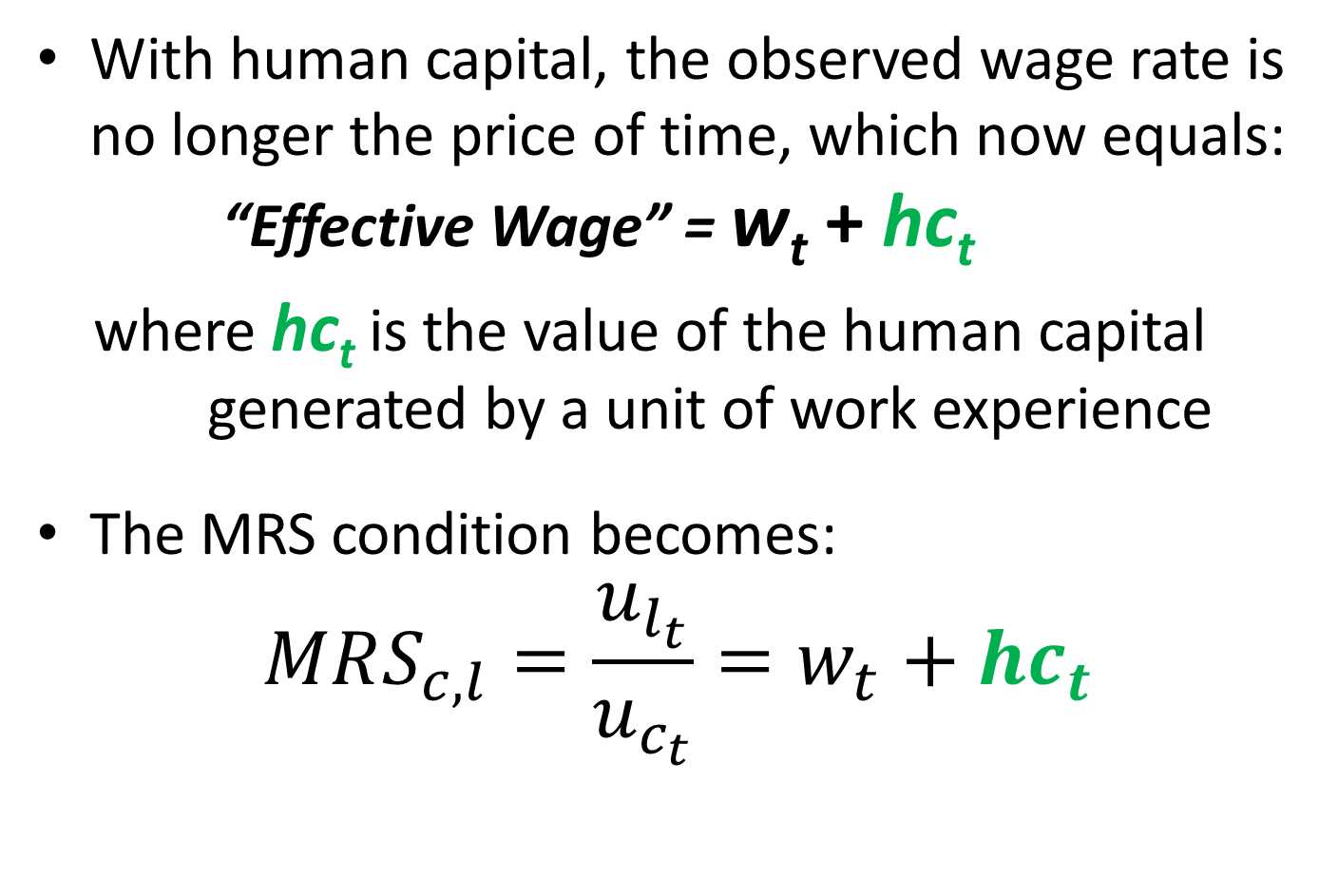
Extension: Work experience builds Human Capital
With human capital, the observed wage rate is no longer the price of time, which now equals: “Effective Wage” = w_{t} + hc_{t}
where hc_{t} is the value of the human capital generated by a unit of work experience
The MRS condition becomes:
$$MRS_{c,l}=\frac{u_{l_{t}}}{u_{c_{t}}}=w_{t}+{hc}_{t}$$

Slide 28
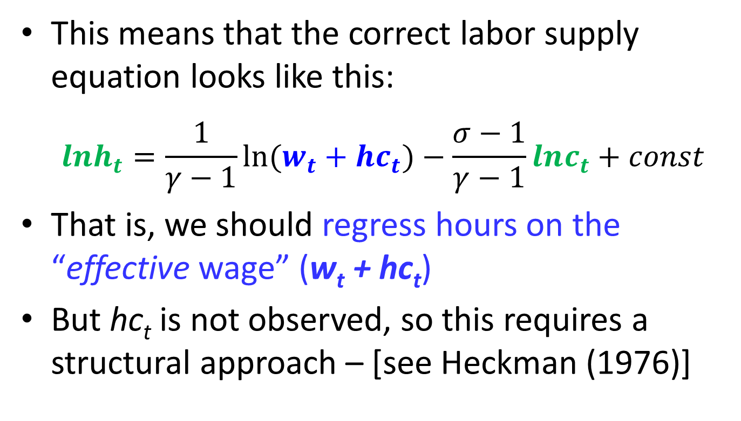
Extension: Work experience builds Human Capital
This means that the correct labor supply equation looks like this:
  $$lnh_{t}=\frac{1}{γ−1}ln⁡(w_{t}+{hc}_{t})−\frac{σ−1}{γ−1}lnc_{t}+const$$
That is, we should regress hours on the “effective wage” (w_{t} + hc_{t})
But hc_{t} is not observed, so this requires a structural approach – [see Heckman (1976)]

Slide 29
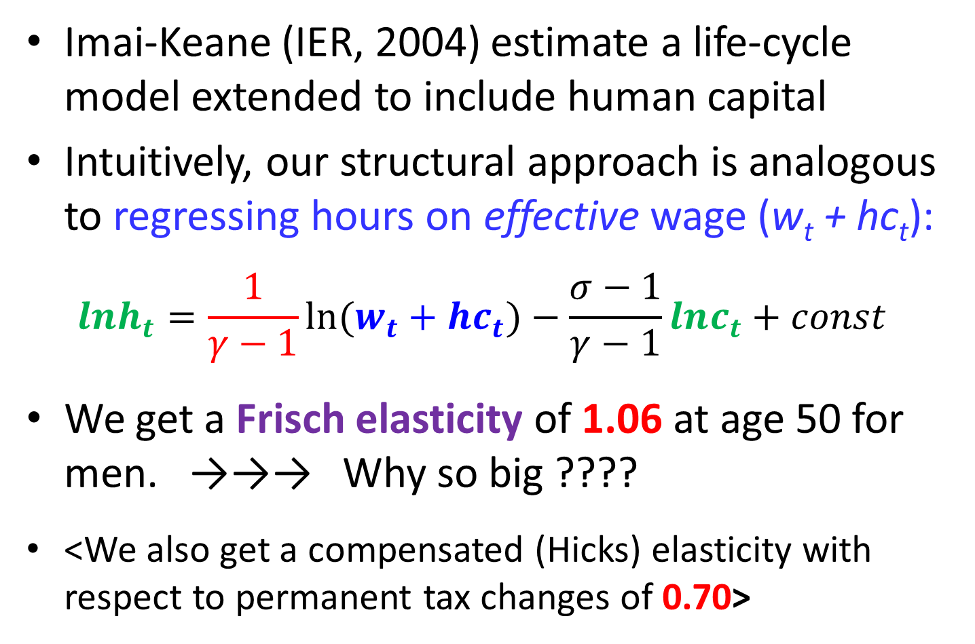
Elasticity estimates are larger with Human Capital
Imai-Keane (IER, 2004) estimate a life-cycle model extended to include human capital
Intuitively, our structural approach is analogous to regressing hours on effective wage (w_{t} + hc_{t}):
  $$lnh_{t}=\frac{1}{γ−1}ln⁡(w_{t}+{hc}_{t})−\frac{σ−1}{γ−1}lnc_{t}+const$$
We get a Frisch elasticity of 1.06 at age 50 for men. →→→ Why so big ????
<We also get a compensated (Hicks) elasticity with respect to permanent tax changes of 0.70>

Slide 30
Hours, Wage and Effective Wage over Life-Cycle
Hours, Wage
“Effective Wage” = Wage + HC return
The Effective Wage (Wage + HC) and Hours track closely over the life-cycle, implying elastic labor supply.
Hence the large Frisch elasticity.
Wage
HC return
Hours
Age

Slide 31
Another Argument for Elastic Labor Supply: The Participation Decision
Classic labor supply studies cited earlier focus on variation in hours conditional on participation.
Hours given participation is VERY flat over life-cycle
Several authors argue labor supply is more elastic on the participation margin:
  Kimmel and Kneisner (JME 1998)
  Ziliak and Kneisner (JOLE 2005)
  French (ReStud 2005)
  Chang and Kim (IER 2006)
  Rogerson and Wallenius (JET 2009, AER 2013)
  Keane and Rogerson (JEL 2012)

Slide 32
The Participation Decision
Papers accounting for participation margin of labor supply do find large Frisch elasticities (for males):
Kimmel and Kneisner (JME 1998) – Frisch 1.25
Ziliak and Kneisner (JOLE 2005) – Frisch 0.54
French (ReStud 2005) – Frisch 1.10 for 60 year old males
Chang and Kim (IER 2006) – Frisch ≈ 0.90
Erosa, Fuster, Kambourov (Restud 2016) obtain Frisch >1 and Hicks = 0.44.

Slide 33
Papers with both Human Capital and Participation:
Chetty (ECMA 2012) pools estimates from many existing studies of tax reforms, and obtains a Hicks elasticity of 0.58 (hours = .33 participation = .25)
Keane and Wasi (EJ 2016) - Hicks elasticity of lifetime hours for men is 0.70.
In summary, there is plenty of recent evidence for elastic labor supply
  Frisch = 1.0 assumed by Conesa et al (2009) seems reasonable

Slide 34
Conesa, Kitao, Krueger (AER 2009)
Recall: Conesa et al (2009) show two main features of their model drive a high capital tax:
  Elastic labor supply (Frisch = 1), and
  Labor supply elasticities grow with age
Why do elasticities that grow with age make a high capital tax optimal?

Slide 35
Why is Age-variation in labor supply elasticities important?
Recall the key idea of optimal tax theory – To minimize distortions: Focus taxes on activities that are inelastically supplied.
If labor supply elasticities rise with age it is optimal to let labor tax rates fall with age:
  Erosa and Gervais (JET 2002)
  Gervais (JEDC 2012)
Notes:
But an age varying tax rate may be difficult to implement politically. A capital tax can approximate a tax on labor income that falls with age.

Slide 36
Age-varying Labor Tax vs. Capital Tax
But…. A labor tax rate that falls with age may be difficult to implement politically.
A capital tax can approximate a labor income tax that falls with age.

Slide 37
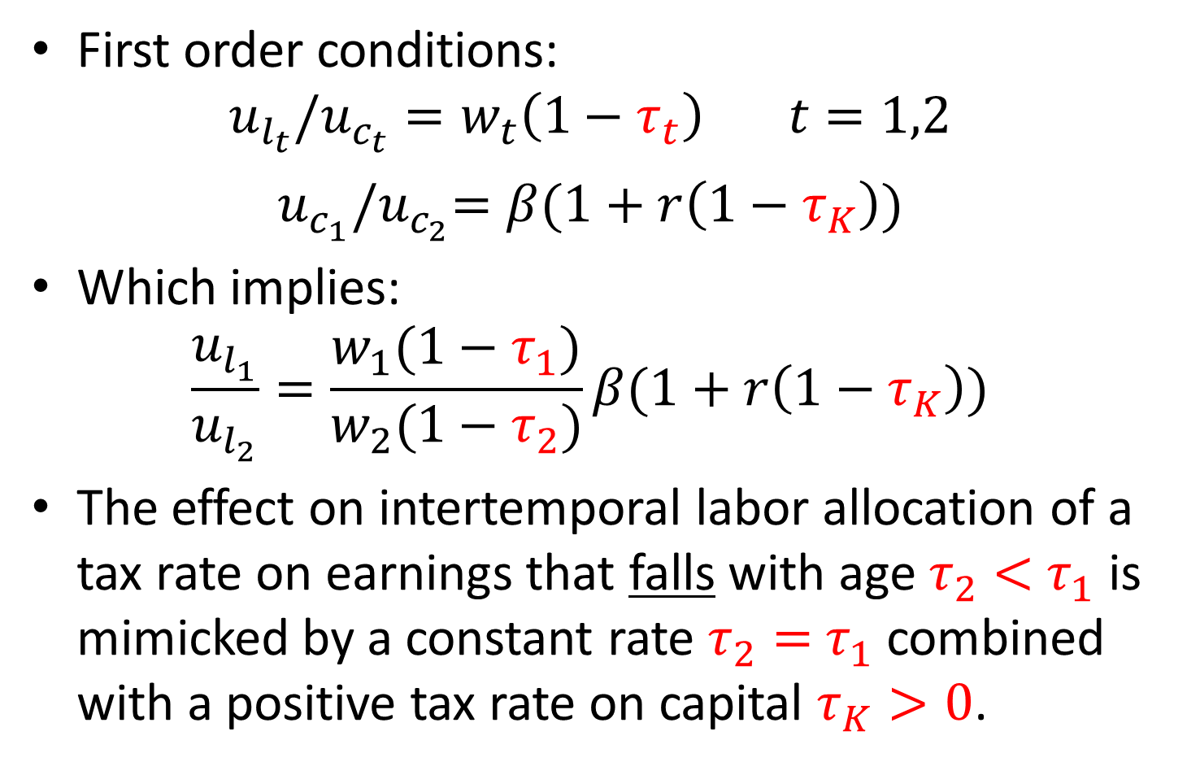
Simple Two-Period Model with Saving and Taxes (exogenous wages)
First order conditions:
$$u_{l_{t}}/u_{c_{t}}=w_{t}\left(1−τ_{t}\right) t=1,2$$
$$u_{c_{1}}{/u}_{c_{2}}=β(1+r\left(1−τ_{K}\right))$$
Which implies:
$$\frac{u_{l_{1}}}{u_{l_{2}}}=\frac{w_{1}(1−τ_{1})}{w_{2}(1−τ_{2})}β(1+r\left(1−τ_{K}\right))$$
The effect on intertemporal labor allocation of a tax rate on earnings that falls with age $τ_{2}<$ $τ_{1}$ is mimicked by a constant rate $τ_{2}=$ $τ_{1}$ combined with a positive tax rate on capital $τ_{K}>0$.

Slide 38
Problem: Evidence on Labor Supply Elasticities by Age is Limited
Blundell, French, Tetlow (Handbook of Economics of Population Aging, 2016, p.527):
“Despite the fact that this is an issue of central importance for optimal taxation over the life cycle, there is relatively little evidence on it.”
“… direct evidence on labor supply elasticities around retirement age is scarce.”
“… evidence is not definitive, but it suggests that labor supply elasticities rise at older ages.”
Notes:
Gomme et al. (NBER Macro, 2005) find that at business-cycle frequencies, the elasticity of labor supply follows a U-shaped pattern over the life cycle—highest at young ages, then falling and rising slightly at older ages.

Slide 39
Strong Theoretical Reasons to Believe Elasticities increase with Age
Human Capital causes labor supply elasticities to grow with age:
  Imai and Keane (IER 2004)
An active Participation Margin causes labor supply elasticities to grow with age:
  French (ReStud 2005)
  Rogerson and Wallenius (JET 2009, AER 2013)
  French and Jones (ITPF 2012)

Slide 40
Human Capital → Labor Supply Elasticity Grows with Age
Hours, Wage
“Effective Wage” = Wage + HC
Wage
HC Return
Age
For young workers, the wage is a fraction of the price of time (~ 50% at age 25-30). Rest is return on human capital.
For old workers: Current Wage ≈ Price of Time
So labor supply gets more sensitive to the wage with age

Slide 41
Participation Margin → Labor Supply Elasticity Grows with Age
Models with a labor force participation margin also imply increasing elasticities with age
Older workers have lower participation rates, and many are nearly indifferent between working and not working
Eric French (ReStud 2005) explains this well:
  “….those in their 60s are near the labour force participation margin. As a result, (Frisch) labour supply elasticities rise from 0.3 at age 40 to 1.1 at age 60.”

Slide 42
There is Some Evidence on Labor Supply Elasticities by Age:
French (ReStud 2005) – Frisch = 0.30 at age 40 to 1.10 at age 60 for males
French and Jones (ITPF 2012) – 0.36 at 40 to 1.28 at 60
Imai-Keane (IER 2004) – Frisch = 0.36 at 25, 1.96 at 60
Iskhakov and Keane (JE 2020)
  Frisch = 0.30 for College males at 30, grows to 1.5 at age 60.
  Frisch = 0.80 for High school at 30, grows to 1.8 at age 60.
French-Stafford (2017) – Frisch ≈ 0 for new fisherman, Frisch = 2.7 for fishermen near retirement.

Slide 43
A Life-cycle model with Human Capital and Participation
Keane and Wasi (EJ 2016) “Labor Supply: the Roles of Human Capital and the Extensive Margin”
We build a Labour Supply model that includes both Human Capital and an Active Participation Margin
We also model the US tax/transfer system in a great deal of detail, including Social Security
We find labor supply elasticities differ greatly by age and education.

Slide 44
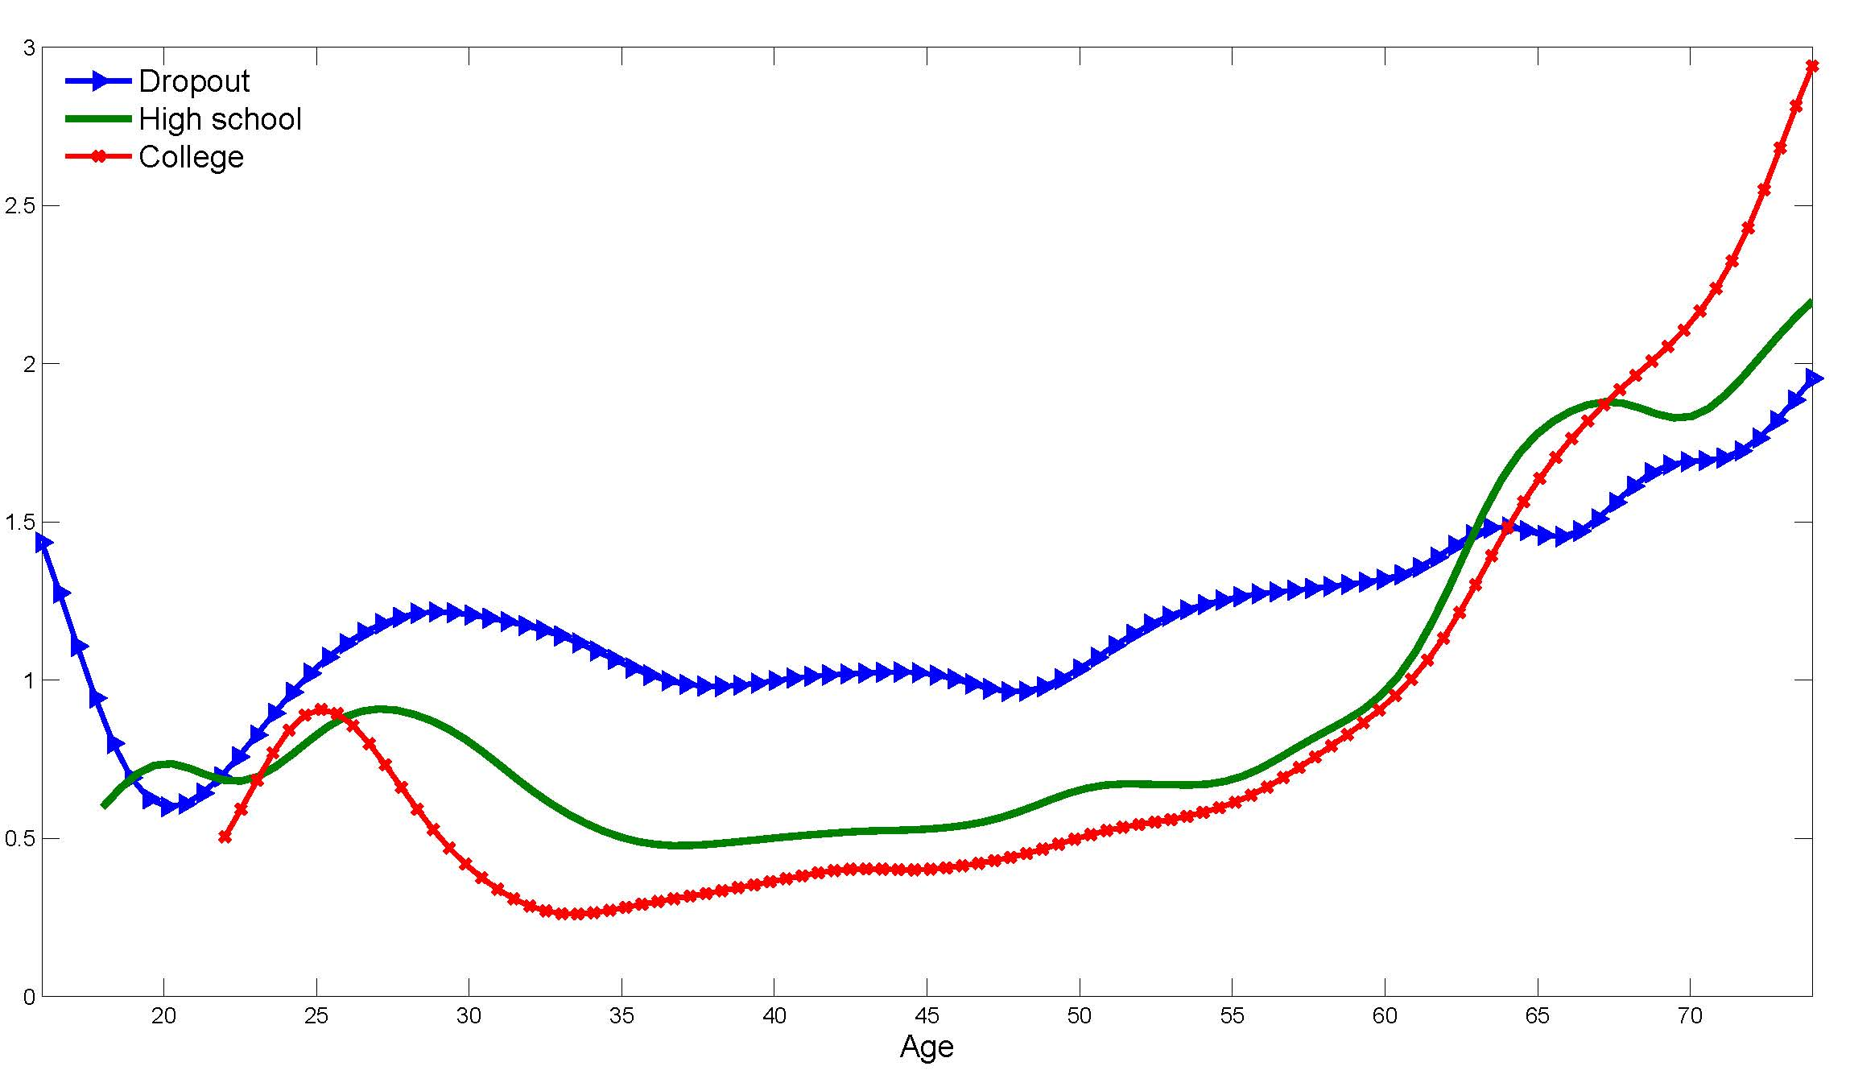
Frisch Elasticities by Age and Education
– Keane-Wasi (EJ, 2016)

Slide 45
Optimal Tax with Human Capital
Extending Conesa, Kitao, Krueger (AER 2009) to analyse optimal tax structure in models that incorporate human capital investment:
  Peterman (RED 2016)
  Da Costa and Santos (IER 2018)
  Badel, Huggett and Lou (EJ 2020)
  Karabarbounis (AEJMacro 2016)
  Blandin and Peterman (EER 2019)

Slide 46
Optimal Tax with Human Capital
Peterman (RED 2016) develops a DSGE-OLG model that includes a learning-by-doing (LBD) form of human capital accumulation
  Includes borrowing constraints
  Does not model labor force participation
  Does not allow bequests to be taxed differently than other assets
Obtains an optimal capital tax rate of 36%, plus a flat-rate labor income tax of 22%.
  Note: Very similar to Conesa et al (2009) results

Slide 47
Optimal Tax with Human Capital
Da Costa and Santos (IER 2018) obtain similar results in a broadly similar setup
They obtain an optimal capital tax rate of 25%, plus a modestly progressive income tax with a 30% top rate.
If Transfers are allowed, there are substantially transfers to those in the bottom decile of the income distribution.
  The top rate is roughly unchanged
  Transfers are mostly financed by an increase in the capital tax rate to 35%.
Notes:
This is a comparison of top and bottom panels of their Table 6 and Figure 3 (right side).

Slide 48
Optimal Tax with Human Capital
Badel, Huggett, Lou (EJ 2020) consider a DSGE model with human capital investment on the job.
  They do not model labour force participation decisions, and they abstract from uncertain mortality, bequests and liquidity constraints.
They calculate the revenue maximizing top rate of the income tax schedule, holding other aspects of tax structure fixed.
Diamond and Saez (JEP 2011) calculate a revenue maximizing top rate of 73% in an exogenous wage framework (no human capital)
BHL find this falls to 49% when they account for human capital. <Optimal top rate is lower>

Slide 49
Human capital and Optimal Tax Structure
Summary: Accounting for human capital formation has two key effects on optimal tax structure:
First, it makes the optimal tax on labor income lower and less progressive.
  Intuitively, incentive to invest in human capital is greatly reduced if higher wages push one into a higher tax bracket.
Second, it makes it optimal to shift part of the tax burden off of labor and onto capital.
  Taxes on physical capital are bad for growth as they reduce capital formation.
  But if labor taxes slow human capital formation, the argument for taxing labor rather than capital is weakened.

Slide 50
Joint vs. Individual Taxation
There is a broad consensus that Labor Supply Elasticities are large for Married Women
  They are close to the participation margin, similar to workers near retirement
So optimal tax theory suggests married women be taxed at a low rate
But many countries do the opposite:
A progressive tax code with joint taxation of couples implies high marginal rates on married women.

Slide 51
Joint vs. Individual Taxation
Bick and Fuchs-Schündeln (Restud 2018)
Countries with high marginal tax rates on the “secondary” earner due to a progressive tax code + joint taxation of couples:
  Germany, Denmark, Belgium, US, France
Countries with individual taxation:
  UK, Austria, Sweden, Greece, Hungary
They show that different tax systems explain a good part of cross-country variation in married women's labor supply. (Denmark is an outlier).

Slide 52
Progressive Taxes and Labor Supply of Married Women
Holter, Krueger, Stepanchuk (IER, 2019)
DSGE-OLG model with both singles and couples
  Exogenous marriage, Endogenous wages for women
  Calibrate model to US data
  “Many two-earner households with high-earning males find it optimal, with a progressive tax system, to only have the male working.”
“… reverting to a flat tax increases the labor force participation rate of married women by 7% …”
  Note: The capital tax is fixed in their experiments.
Notes:
Flat tax is 17.3% which is the average US level.

Slide 53
Joint vs. Individual Taxation
Abolishing joint taxation of couples and shifting to individual taxation is another way to lower marginal tax rates on married women:
Guner, Kaygusuz, Ventura (ReStud, 2012)
  DSGE-OLG model with exogenous marriage
  Endogenous human capital and participation
  Shift to individual taxation increases labor supply of married women by 11.4%. (Aggregate output +3.8%).
  Shift to a flat tax increases labor supply of married women by 8.8%
  Both reforms increase welfare.
  Note: Tax rate on capital fixed at 9.7%

Slide 54
Joint vs. Individual Taxation
Other papers get very similar results:
Borella, DeNardi, Yang (MRRC, 2017)
  Life-Cycle model
  Endogenous marriage, human capital, participation
  Abolishing joint taxation of couples increases employment of married women by roughly 10%

Slide 55
Joint vs. Individual Taxation
Eckstein, Keane and Lifshitz (ECMA, 2019)
Life-cycle model with endogenous marriage, human capital, participation and education choice
A shift to individual taxation:
  Increases employment of married women by 8.3%
  Increases college education of married women 4.2%
  Increases tax revenue by 9%
  Reduces divorce rate by 4.3%, increases marriage 8%.
  Very minor effects on labor supply of men and single women
All 4 studies find individual taxation is a good idea

Slide 56
Conclusion
Labor supply models that account for human capital and the participation margin imply that:
  Labor supply is more elastic than previously thought
  Elasticities grow with age
  Elasticities are high for married women and workers near retirement (people with low participation rates)
When plugged into optimal tax calculations, the principle of low taxes on elastic factors implies:
  A less progressive income tax
  Higher tax rates on capital
  A shift toward individual taxation of couples

Slide 57
Conclusions
Labor supply elasticities that grow with age favor a higher capital tax, but:
Evidence on how elasticities vary by age is limited
Given that optimal tax structure (especially the capital tax) depends a lot on how elasticities vary by age, much more work is needed on this topic.

Slide 58
Conclusions
In models that include married women with elastic labor supply:
  Optimal progressivity of the tax code is reduced
  A shift to individual taxation is welfare enhancing
How does accounting for marriage affect the optimal capital tax?? <Not known.>

Slide 59
Conclusion
Gap in the Literature:
The frontier is to study optimal tax structure – both income and capital tax – in models that include:
  Endogenous wages + Participation Decisions
  Workers that differ by Education
  Both single workers and married couples
No one has done this to my knowledge.

Slide 60
Extra Material
I showed how labor supply elasticities are biased towards zero by failure to account for a learning-by-doing (LBD) form of human capital
It is simple to show how the same problem arises in a model with on-the-job training (OJT), an alternative form of human capital accumulation. (See Below).
There are also a few other interesting papers (see below).

Slide 61
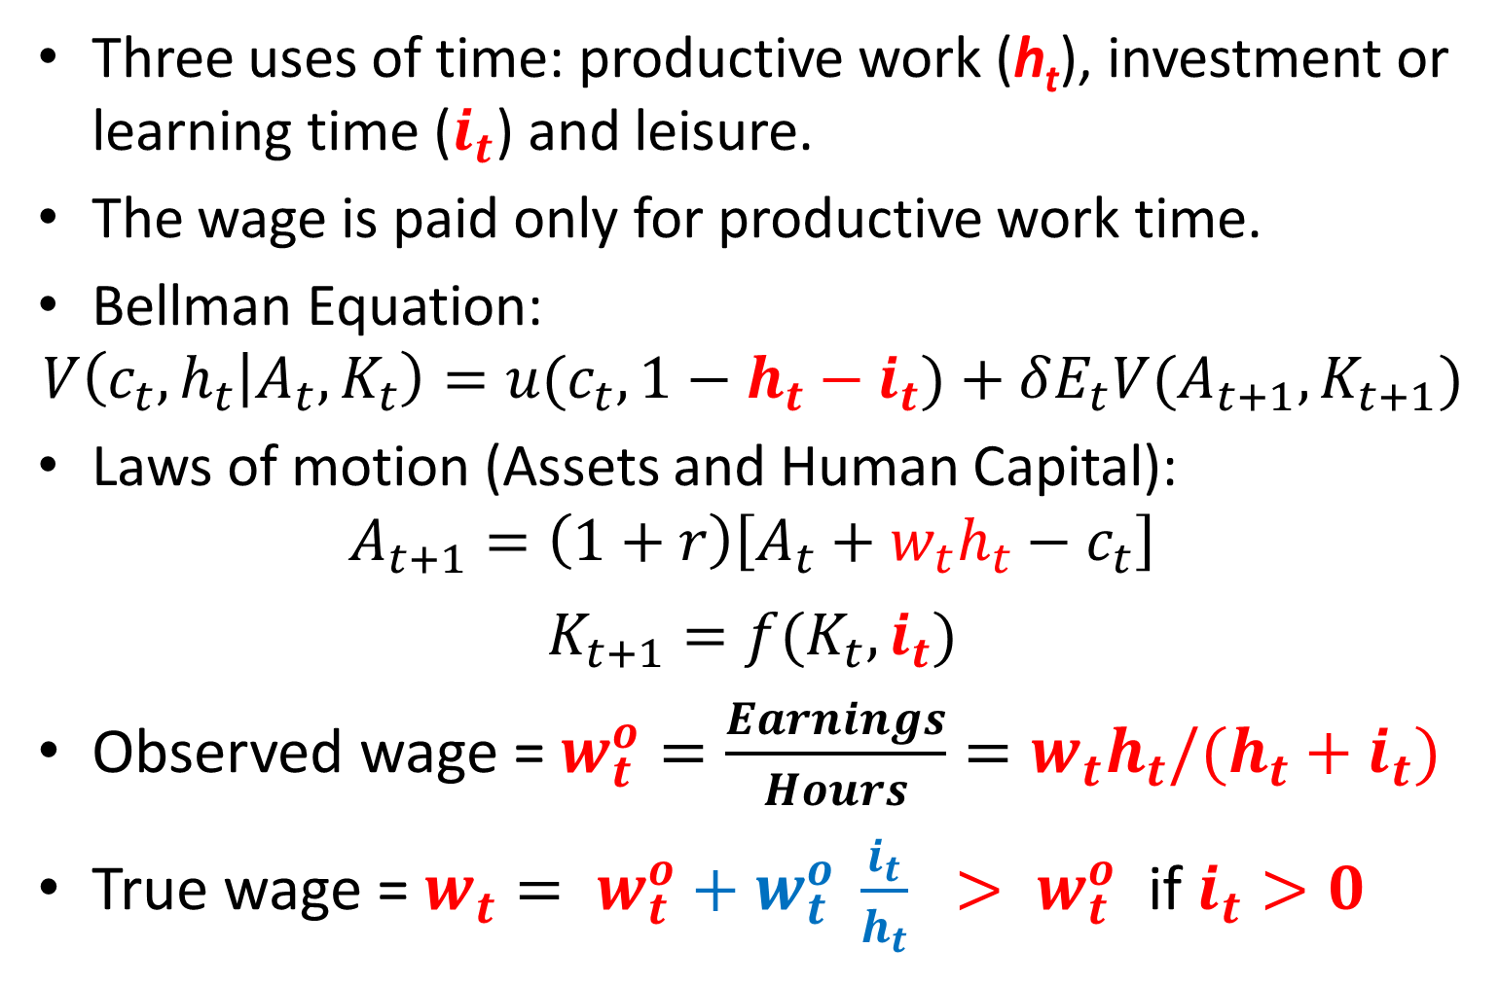
The on-the-job training (OJT) model
Three uses of time: productive work (h_{t}), investment or learning time ($i_{t}$) and leisure.
The wage is paid only for productive work time.
Bellman Equation:
$$V\left(c_{t},h_{t} | A_{t},K_{t}\right)=u(c_{t},1−h_{t}−i_{t})+δE_{t}V(A_{t+1},K_{t+1})$$
Laws of motion (Assets and Human Capital):
$$A_{t+1}=\left(1+r\right)\left[A_{t}+w_{t}h_{t}−c_{t}\right]$$
$$K_{t+1}=f(K_{t},i_{t})$$
Observed wage = ${w_{t}^{o}=\frac{Earnings}{Hours}=w_{t}h_{t}/(h_{t}+i}_{t})$
True wage = ${w_{t}= w}_{t}^{o}+w_{t}^{o} \frac{i_{t}}{h_{t}} > w_{t}^{o}$ if $i_{t}>0$

Slide 62
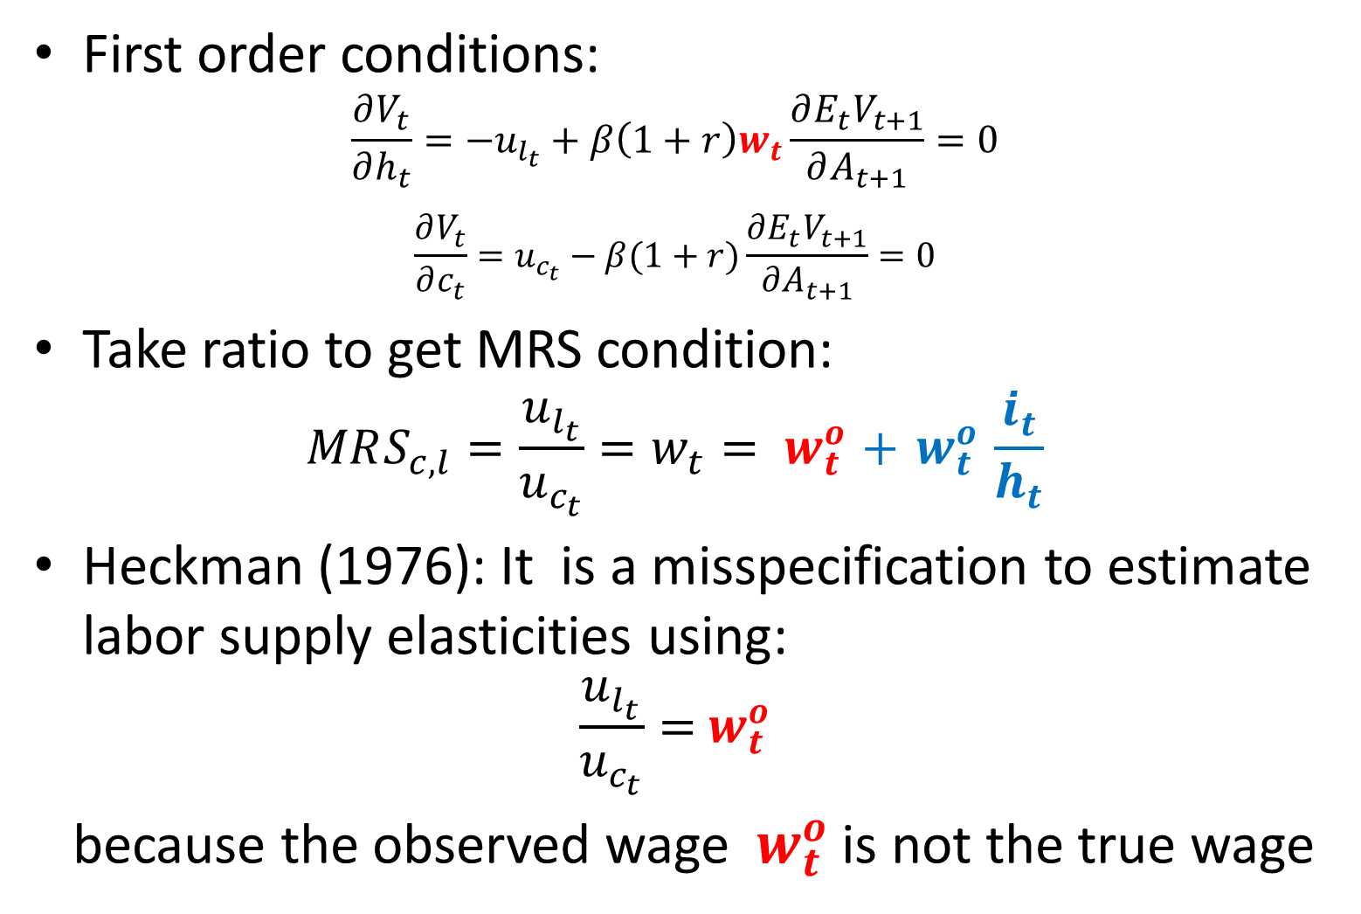
HC model with OJT gives same result as LBD
First order conditions:
$$\frac{∂V_{t}}{∂h_{t}}=−u_{l_{t}}+β\left(1+r\right)w_{t}\frac{∂E_{t}V_{t+1}}{∂A_{t+1}}=0$$
$$\frac{∂V_{t}}{∂c_{t}}=u_{c_{t}}−β(1+r)\frac{∂E_{t}V_{t+1}}{∂A_{t+1}}=0$$
Take ratio to get MRS condition:
$$MRS_{c,l}=\frac{u_{l_{t}}}{u_{c_{t}}}=w_{t}{= w}_{t}^{o}+{ w}_{t}^{o} \frac{i_{t}}{h_{t}}$$
Heckman (1976): It is a misspecification to estimate labor supply elasticities using:
$$\frac{u_{l_{t}}}{u_{c_{t}}}={ w}_{t}^{o}$$
because the observed wage ${ w}_{t}^{o}$ is not the true wage

Slide 63
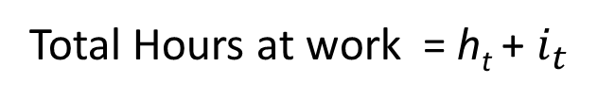

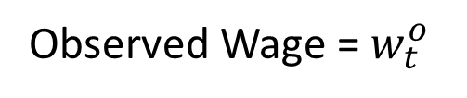
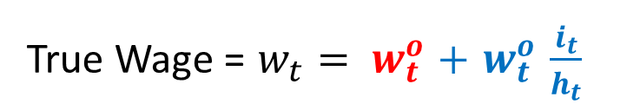
OJT Model: Hours, Wage, True Wage over Life-Cycle
Hours, Wage
True Wage = $w_{t}{= w}_{t}^{o}+{ w}_{t}^{o} \frac{i_{t}}{h_{t}}$
Observed wage grows rapidly over first half of life-cycle, but hours grow slowly → Inelastic labor supply
True wage and hours track closely, implying elastic labor supply – Note: Same basic story as Learning-by-Doing (LBD) model
Observed Wage =${ w}_{t}^{o}$
Total Hours at work = h_{t} + $i_{t}$
$$i_{t}/h_{t}$$
Age

Slide 64
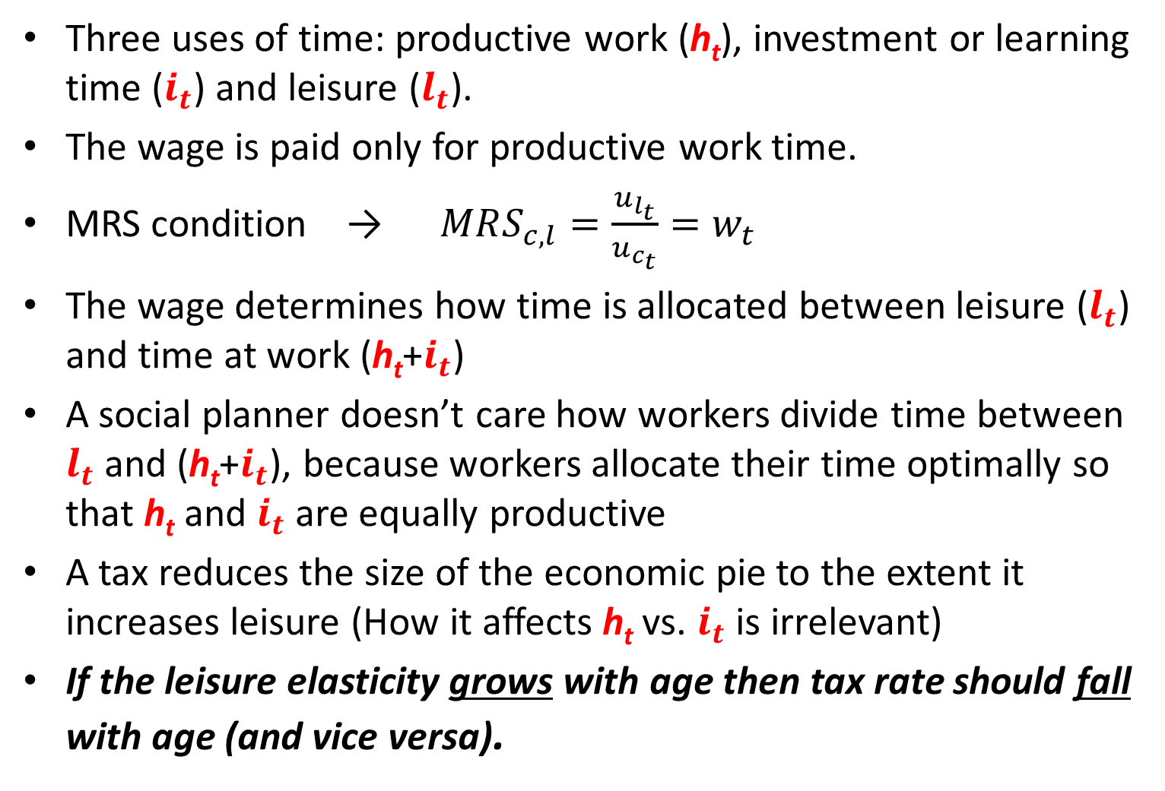
The on-the-job training (OJT) model
Three uses of time: productive work (h_{t}), investment or learning time ($i_{t}$) and leisure ($l_{t}$).
The wage is paid only for productive work time.
MRS condition → $MRS_{c,l}=\frac{u_{l_{t}}}{u_{c_{t}}}=w_{t}$
The wage determines how time is allocated between leisure ($l_{t}$) and time at work (h_{t}+$i_{t}$)
A social planner doesn’t care how workers divide time between $l_{t}$ and (h_{t}+$i_{t}$), because workers allocate their time optimally so that h_{t} and $i_{t}$ are equally productive
A tax reduces the size of the economic pie to the extent it increases leisure (How it affects h_{t} vs. $i_{t}$ is irrelevant)
If the leisure elasticity grows with age then tax rate should fall with age (and vice versa).

Slide 65
Optimal Tax Learning-by-Doing vs. On-the-job Training
Da Costa and Santos (2018) compare optimal tax results for the LBD and OJT models
They give very similar conclusions about the optimal tax structure. (As expected from above analysis).
So it seems the particular model of human capital investment is not importance to the results
But Blandin and Peterman (EER 2019) get very different results in an OJT model
Need more work to explain the difference. My suspicion is that the BP result is not robust.

Slide 66
Participation and Optimal Tax Structure
Saez (2002) shows that accounting for labour force participation matters for another reason.
He shows that if participation is sufficiently elastic with respect to the wage rate, it may be optimal to have a tax structure that involves negative tax rates at low levels of earnings.
This is a way to both (i) encourage labour force participation and (ii) help the working poor by supplementing their earnings.
A system with negative tax rates at low income levels is often called an “earned income tax credit” (EITC) system.

Slide 67
Participation and Optimal Tax Structure
Karabarbounis (2016) is the only optimal tax analysis in a model with human capital, borrowing constraints and labor force participation.
Limitation: he optimizes over a single parameter that shifts the entire income tax schedule up or down for workers of different ages, while holding both progressivity and the tax on capital fixed.
Participation elasticities are large for young and old households.
Therefore, both young and old households should pay relatively low taxes on labour earnings compared to middle aged households.
However, this analysis does not address the central issues of (i) how to tax capital vs. labour and (ii) progressivity of the income tax.
A key feature of Karabarbounis’ model is that all households consist of married couples. This accentuates the role of the participation margin, as households can choose to have one, both or neither partner work. However, it is unrealistic to ignore single households.

Slide 68
Marriage and the Capital Tax
In a recent ANU Ph.D. thesis, Freestone (2020) considers an extension of the Conesa et al (2009) et al. to include single and married couples and transitions between marital states.
He finds that accounting for marriage changes the optimal tax structure considerably:
Freestone finds that capital should not be taxed.
He argues that dual labour supply lowers earnings risk (provided the wage shocks of the couple are not too highly correlated) and this reduces saving.
In an environment with a high level of earnings risk, one may get “over saving,” as in Aiyigari (1994). A capital tax is then beneficial, as it lowers savings towards the optimal level. But introducing marriage lowers savings, so a capital tax is no longer optimal.
But Freestone does not have human capital in his model, so the no capital tax result may not generalize

Slide 69
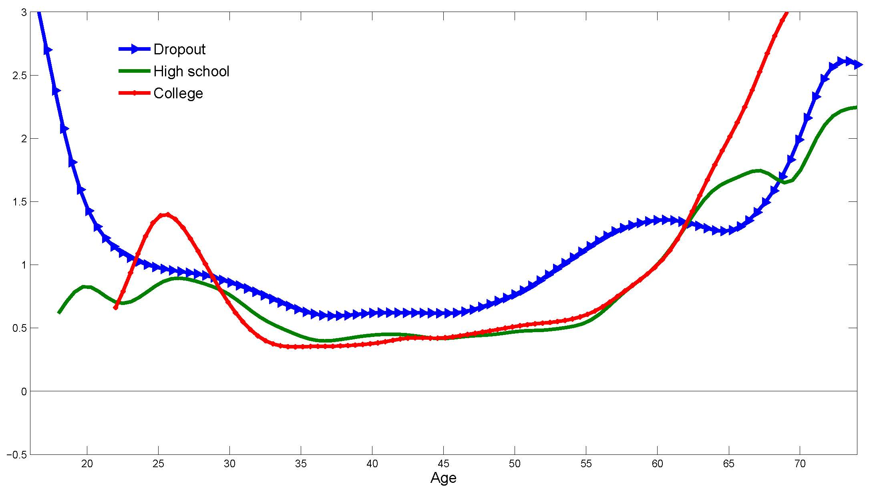
Hicks Elasticities by Age and Education
– Keane-Wasi (EJ, 2016)
Notes:
Note the U-shape for dropouts. But generally increasing with age for HS and College types.

